Slide 1
Unit 5

Slide 2
What is JavaScript ?
It is also known as the scripting language for webpages.
It is well-known for the development of web pages, and many non-browser environments also use it.
JavaScript is a weakly typed language (dynamically typed).
JavaScript can be used for Client-side developments as well as Server-side developments.
JavaScript is both an imperative and declarative type of language.
JavaScript contains a standard library of objects, like Array, Date, and Math, and a core set of language elements like operators, control structures, and statements.

Slide 3
🔹 Client-Side Development
Definition: Code that runs in the user's browser (the client).
✅ Key Points:
Focuses on what the user sees and interacts with.
Written using HTML, CSS, and JavaScript.
Handles UI, layout, animations, form validation, and local interactions.
Runs directly on the user’s device (browser).
✅ Examples:
A dropdown menu that expands when clicked.
Validating a form before submitting it.
Animating a button when hovered.
✅ Technologies:
Languages: HTML, CSS, JavaScript
Frameworks: React, Angular, Vue.js

Slide 4
🔹 Server-Side Development
Definition: Code that runs on the web server, not visible to the user.
✅ Key Points:
Handles business logic, database operations, authentication, etc.
Generates and sends content/data to the client.
Manages APIs, processes forms, stores data.
✅ Examples:
Saving form data into a database.
Checking login credentials.
Sending a confirmation email.
✅ Technologies:
Languages: Python, Node.js, PHP, Java, Ruby, Go
Frameworks: Express (Node.js), Django (Python), Spring Boot (Java), Laravel (PHP)

Slide 5
Feature | Client-Side | Server-Side
Runs on | User’s browser | Web server
Language examples | HTML, CSS, JavaScript | Node.js, Python, PHP, Java
Access to database | ❌ No | ✅ Yes
Main use | UI, interactivity | Data processing, backend logic
Visibility | Visible to user (source viewable) | Hidden from user

Slide 6
🔹 Strongly Typed Language
A language where types are enforced strictly. You cannot mix data types without explicit conversion.
✅ Characteristics:
Variables have clearly defined types.
Type errors are caught at compile-time or runtime.
Prevents unintended operations between mismatched types.
You must explicitly convert types.
✅ Examples:
Python
Java
C#
Swift
✅ Example in Python:
python
x = "5" y = 2 print(x + y) # ❌ Error: can't add str and int # Correct: print(int(x) + y) # ✅ Output: 7

Slide 7
🔹 Weakly Typed Language
Definition: A language where the system automatically converts between types. Type rules are loose, which can lead to unexpected results.
✅ Characteristics:
Implicit type coercion is allowed.
Type mismatches may not cause errors.
Easier to write quick code but prone to bugs.
Sometimes called loosely typed.
✅ Examples:
JavaScript
PHP
Perl
C (partially)
✅ Example in JavaScript:
javascript
let x = "5"; let y = 2; console.log(x + y); // ✅ "52" (string concatenation) console.log(x - y); // ✅ 3 (string "5" is coerced to number)

Slide 8
Imperative Programming
Definition: Tells the computer how to do something — step-by-step instructions.
✅ Key Characteristics:
Focuses on control flow (what to do and how to do it)
Uses loops, conditionals, and variables
Closer to machine-level logic
You explicitly manage the state
✅ Examples:
C
C++
Java
Python (mostly imperative)
JavaScript

Slide 9
🔹 Declarative Programming
Definition: Tells the computer what to do, not how to do it — focuses on result, not steps.
✅ Key Characteristics:
Focuses on what the outcome should be
Leaves control flow to the language or engine
Less code, more readable
Often used in data processing, UI, or database work
✅ Examples:
SQL
HTML
Prolog
Haskell (functional)
JSX (in React)
CSS (style declarations)
✅ Example (SQL):
sql
SELECT SUM(number) FROM numbers_table WHERE number <= 5;
💡 You declare the desired result — the system figures out how.

Slide 10
Example
// Find sum of numbers from 1 to 5
int sum = 0;
for (int i = 1; i <= 5; i++) {
sum += i;
}
printf("%d", sum); // Output: 15

Slide 11
How to Link JavaScript File in HTML ?
JavaScript can be added to HTML file in two ways:
Internal JS: We can add JavaScript directly to our HTML file by writing the code inside the <script> tag. The <script> tag can either be placed inside the <head> or the <body> tag according to the requirement.
External JS: We can write JavaScript code in another files having an extension.js and then link this file inside the <head> tag of the HTML file in which we want to add this code.

Slide 12
History of JavaScript
It was created in 1995 by Brendan Eich while he was an engineer at Netscape. It was originally going to be named LiveScript but was renamed.
Unlike most programming languages, JavaScript language has no concept of input or output.
It is designed to run as a scripting language in a host environment, and it is up to the host environment to provide mechanisms for communicating with the outside world.
The most common host environment is the browser.

Slide 13
Functions in JS are objects. They may have properties and methods just like other objects. They can be passed as arguments in other functions.
Can handle date and time.
Performs Form Validation although the forms are created using HTML.
No compiler is needed.

Slide 14
Finding HTML Elements
Method | Description
document.getElementById(id) | Find an element by the element id
document.getElementsByTagName(name) | Find elements by tag name
document.getElementsByClassName(name) | Find elements by class name

Slide 15
Tag Name
<html>
<body>
<p>Finding </p>
<p>This example.</p>
<p id="demo"></p>
<script>
const y = document.getElementsByTagName(‘p’);
document.getElementById(‘demo’).innerHTML =
'The first paragraph is: ' + y[0].innerHTML;
</script>
</body>
</html>

Slide 16
Class Name
<html>
<body>
<p class="intro">Hello World!</p>
<p class="intro">This example </p>
<p id="demo"></p>
<script>
const x = document.getElementsByClassName(‘intro’);
document.getElementById(‘demo’).innerHTML =
'The first paragraph is: ' + x[0].innerHTML;
</script>
</body>
</html>

Slide 17
Alert!!!
<!DOCTYPE html>
<html>
<body>
<h1>The button Element</h1>
<button type="button" onclick="alert('Hello world!')">Click Me!</button>
</body>
</html>

Slide 18
The DOM Programming Interface
The HTML DOM can be accessed with JavaScript (and with other programming languages).
In the DOM, all HTML elements are defined as objects.
The programming interface is the properties and methods of each object.
A property is a value that you can get or set (like changing the content of an HTML element).
A method is an action you can do (like add or deleting an HTML element).

Slide 19
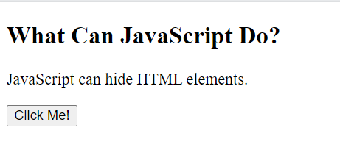
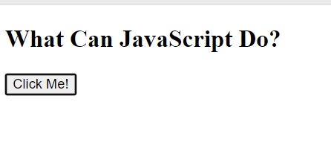
MAKING CONTENT INVISIBLE- DOM(HTML)
<!DOCTYPE html>
<html>
<body>
<h2>What Can JavaScript Do?</h2>
<p id="demo">JavaScript can hide HTML elements.</p>
<button type="button" onclick="document.getElementById('demo').style.display='none'">Click Me!</button>
</body>
</html>

Slide 20
Change Content
<!DOCTYPE html>
<html>
<body>
<h2>What Can JavaScript Do?</h2>
<p id="demo">JavaScript can change HTML content.</p>
<button onclick=“document.getElementById(‘demo’).innerHTML = ‘Hello JavaScript!’”>Click Me!</button>
</body>
</html>

Slide 21
Changing Image – DOM(HTML)
!DOCTYPE html> <html> <body> <img id="myImage" src="smiley.gif"> <script> document.getElementById("myImage").src = "landscape.jpg"; </script> </body> </html>

Slide 22
Changing CSS
<html>
<body>
<h2>JavaScript HTML DOM</h2>
<p>Changing the HTML style:</p>
<p id="p1">Hello World!</p>
<p id="p2">Hello World!</p>
<script>
document.getElementById(‘p2’).style.color = ‘blue’;
document.getElementById(‘p2’).style.fontFamily = ‘Arial’;
document.getElementById(‘p2’).style.fontSize = ‘larger’;
</script>
</body>
</html>

Slide 23
Write Calculations
<!DOCTYPE html>
<html>
<body>
<h2>My First Web Page</h2>
<p>My first paragraph.</p>
<button type="button" onclick="document.write(5 + 6)">Try it</button>
</body>
</html>

Slide 24
Print Addition Using Javascript
<html>
<body>
<script>
var a=10;
var b=20;
var c=a+b;//It adds values of a and b variable
document.write(c);//prints sum of 10 and 20
document.write(‘\n’);
</script>
</body>
</html>

Slide 25
Window Alert
<!DOCTYPE html>
<html>
<body>
<h2>My First Web Page</h2>
<p>My first paragraph.</p>
<script>
window.alert(5 + 6);
</script>
</body>
</html>

Slide 26
Alert! USING SCRIPT TAG
<!DOCTYPE html> <html> <body> <h1>My First Web Page</h1> <p>My first paragraph.</p> <script> alert(5 + 6); </script> </body> </html>

Slide 27
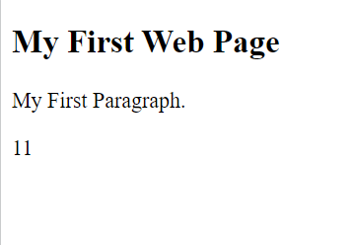
CALCULATIONS
<!DOCTYPE html>
<html>
<body>
<h2>My First Web Page</h2>
<p>My First Paragraph.</p>
<p id="demo"></p>
<script>
document.getElementById("demo").innerHTML = 5 + 6;
</script>
</body>
</html>

Slide 28
Script Inside Body- CHANGING CONTENT
<!DOCTYPE html>
<html>
<body>
<h2>JavaScript in Body</h2>
<p id="demo"></p>
<script>
document.getElementById("demo").innerHTML = "My First JavaScript";
</script>
</body>
</html>

Slide 29
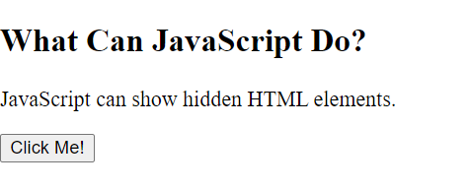
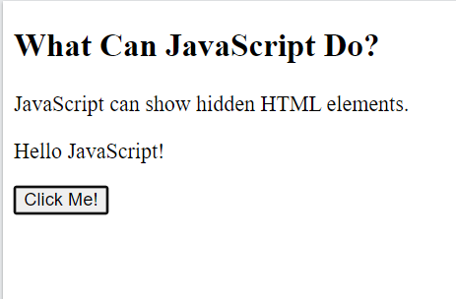
MAKE INVISIBLE VISIBLE
<!DOCTYPE html>
<html>
<body>
<h2>What Can JavaScript Do?</h2>
<p>JavaScript can show hidden HTML elements.</p>
<p id="demo" style="display:none">Hello JavaScript!</p>
<button type="button" onclick="document.getElementById('demo').style.display='block'">Click Me!</button>
</body>
</html>

Slide 30
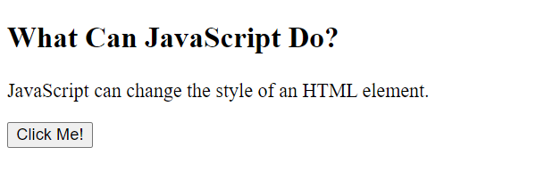
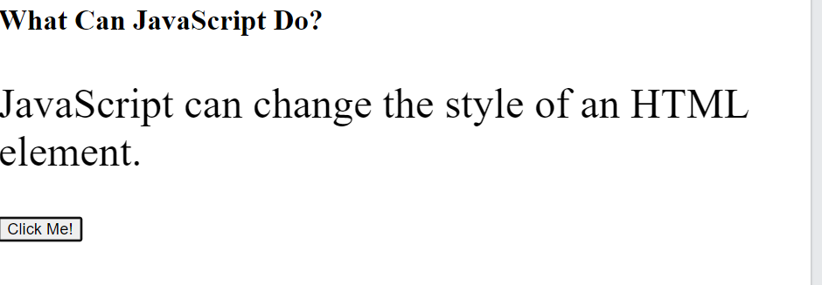
CHANGE FONT SIZE
<!DOCTYPE html>
<html>
<body>
<h2>What Can JavaScript Do?</h2>
<p id="demo">JavaScript can change the style of an HTML element.</p>
<button type="button" onclick="document.getElementById('demo').style.fontSize='35px'">Click Me!</button>
</body>
</html>

Slide 31
Date and Time
<!DOCTYPE html>
<html>
<body>
<h2>My First JavaScript</h2>
<button type="button"
onclick="document.getElementById('demo').innerHTML = Date()">
Click me to display Date and Time.</button>
<p id="demo"></p>
</body>
</html>

Slide 32
Dynamic Content- DOM
<!DOCTYPE html>
<html>
<body>
<p id="demo"></p>
<script>
document.getElementById(‘demo’).innerHTML = ‘Date : ‘ + Date();
</script>
</body>
</html>

Slide 33
Onclick Event
<!DOCTYPE html>
<html>
<body>
<h1>JavaScript HTML Events</h1>
<h2>The onclick Attribute</h2>
<h2 onclick="this.innerHTML='Ooops!'">Click on this text!</h2>
</body>
</html>

Slide 34
Onclick function
<!DOCTYPE html>
<html>
<body>
<h2 onclick="changeText(this)">Click on this text!</h2>
<script>
function changeText(id) {
id.innerHTML = "Ooops!";
}
</script>
</body>
</html>

Slide 35
Print on the Page
<!DOCTYPE html>
<html>
<body>
<h2>The window.print() Method</h2>
<p>Click the button to print the current page.</p>
<button onclick="window.print()">Print this page</button>
</body>
</html>

Slide 36
Creating Functions
<!DOCTYPE html>
<html>
<body>
<h2>JavaScript Statements</h2>
<p>JavaScript code blocks are written between { and }</p>
<button type="button" onclick="myFunction()">Click Me!</button>
<p id="demo1"></p>
<p id="demo2"></p>
<script>
function myFunction() {
document.getElementById("demo1").innerHTML = "Hello Dolly!";
document.getElementById("demo2").innerHTML = "How are you?";
}
</script>
</body>
</html>

Slide 37
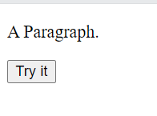
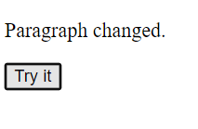
Changing Content- Function
<!DOCTYPE html>
<html>
<head>
<script>
function myFunction() {
document.getElementById("demo").innerHTML = "Paragraph changed.";
}
</script>
</head>
<body>
<p id="demo">A Paragraph.</p>
<button type="button" onclick="myFunction()">Try it</button>
</body>
</html>

Slide 38
VARIABLES AND USE
The var keyword was used in all JavaScript code from 1995 to 2015.
The let and const keywords were added to JavaScript in 2015.
The var keyword should only be used in code written for older browsers.

Slide 39
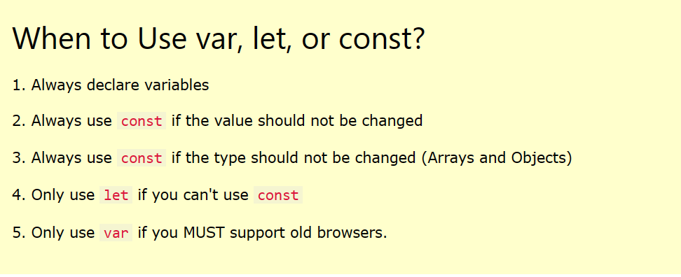

Slide 40
USING LET
<!DOCTYPE html>
<html>
<body>
<h1>JavaScript Variables</h1>
<p>In this example, x, y, and z are variables.</p>
<p id="demo"></p>
<script>
let x = 5;
let y = 6;
let z = x + y;
document.getElementById("demo").innerHTML =
"The value of z is: " + z;
</script>
</body>
</html>

Slide 41
USING CONST
<!DOCTYPE html>
<html>
<body>
<h1>JavaScript Variables</h1>
<p>In this example, x, y, and z are variables.</p>
<p id="demo"></p>
<script>
const x = 5;
const y = 6;
const z = x + y;
document.getElementById("demo").innerHTML =
"The value of z is: " + z;
</script>
</body>
</html>

Slide 42
Simple Addition
<!DOCTYPE html>
<html>
<body>
<h1>JavaScript Variables</h1>
<p>In this example, price1, price2, and total are variables.</p>
<p id="demo"></p>
<script>
const price1 = 5;
const price2 = 6;
let total = price1 + price2;
document.getElementById("demo").innerHTML =
"The total is: " + total;
</script>
</body>
</html>

Slide 43
Using Variables
<!DOCTYPE html>
<html>
<body>
<h1>JavaScript Variables</h1>
<p>Create a variable, assign a value to it, and display it:</p>
<p id="demo"></p>
<script>
let carName = "Volvo";
document.getElementById("demo").innerHTML = carName;
</script>
</body>
</html>

Slide 44
SCOPE
<!DOCTYPE html>
<html>
<body>
<h2>Redeclaring a Variable Using let</h2>
<p id="demo"></p>
<script>
let x = 10;
// Here x is 10
{
let x = 2;
// Here x is 2
}
// Here x is 10
document.getElementById("demo").innerHTML = x;
</script>
</body>
</html>

Slide 45
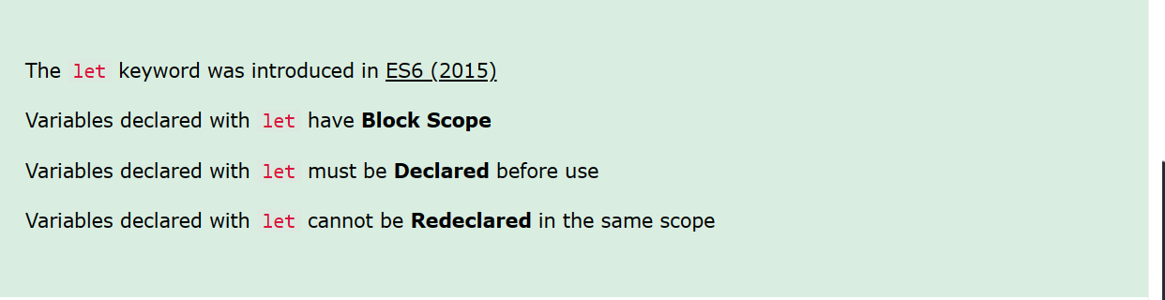
Scope of Let

Slide 46
<!DOCTYPE html>
<html>
<body>
<h2>Redeclaring a Variable Using var</h2>
<p id="demo"></p>
<script>
var x = 10;
// Here x is 10
{
var x = 2;
// Here x is 2
}
// Here x is 2
document.getElementById("demo").innerHTML = x;
</script>
</body>
</html>

Slide 47
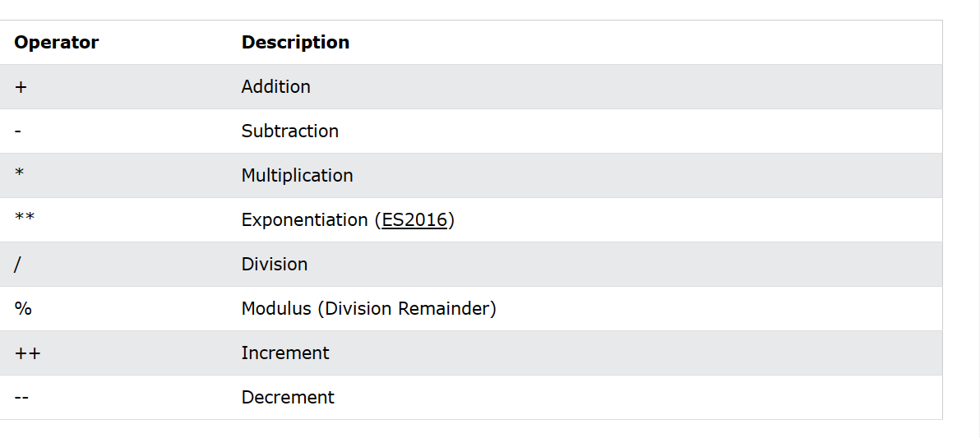
Operators

Slide 48
Area of a Circle
<html>
<head>
</head>
<body>
<script>
function area(){
var a=10;
var c=a*a;//It adds values of a and b variable
document.write(c);//prints sum of 10 and 20
}
</script>
<p id="my"></p>
<button onclick="area()">Area</button>
</body>
</html>

Slide 49
New Line
document.write("<br>");
document.writeln("Hello World!");

Slide 50
JavaScript has 8 Datatypes
String Number Bigint Boolean Undefined Null Symbol Object

Slide 51
// Numbers: let length = 16; let weight = 7.5; // Strings: let color = "Yellow"; let lastName = "Johnson"; // Booleans let x = true; let y = false; // Object: const person = {firstName:"John", lastName:"Doe"}; // Array object: const cars = ["Saab", "Volvo", "BMW"]; // Date object: const date = new Date("2022-03-25");

Slide 52
JavaScript Numbers
All JavaScript numbers are stored as decimal numbers (floating point).
Numbers can be written with, or without decimals:

Slide 53
Exponential Notation
Extra large or extra small numbers can be written with scientific (exponential) notation:
Example
let y = 123e5; // 12300000 let z = 123e-5; // 0.00123

Slide 54
Exponential
<html>
<body>
<h2>JavaScript Numbers</h2>
<p>Extra large or extra small numbers can be written with scientific (exponential) notation:</p>
<p id="demo"></p>
<script>
let y = 123e5;
let z = 123e-5;
document.getElementById("demo").innerHTML =
y + "<br>" + z;
</script>
</body>
</html>

Slide 55
Boolean
<html>
<body>
<h2>JavaScript Booleans</h2>
<p>Booleans can have two values: true or false:</p>
<p id="demo"></p>
<script>
let x = 5;
let y = 5;
let z = 6;
document.getElementById("demo").innerHTML =
(x == y) + "<br>" + (x == z);
</script>
</body>
</html>

